Slide 1
Java第32堂
香港編程學會
Peter

Slide 2
Agenda
Debug Tool
OOP in Java Swing
香港編程學會

Slide 3
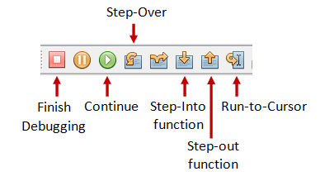
Netbeans Debugger

Slide 4
OOP In Java Swing
What inheritance means
What interface means
What data encapsulation means

