Slide 1
LeetCode訓練營 第3堂
香港編程學會
Collection II

Slide 2
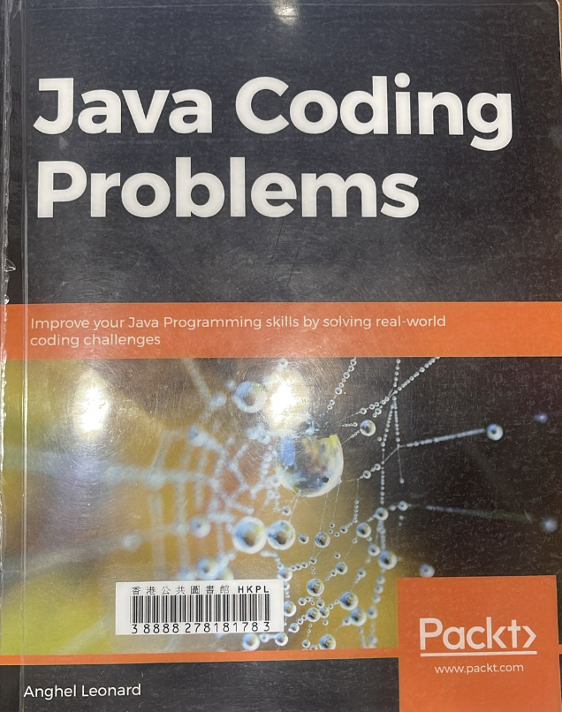

Slide 3
https://github.com/quantrpeter/leetcode-lesson-2

Slide 4
Sort an Array
Find Element
Check array equal or mismatch
Compare two arrays lexicographically
Create stream from array
Min, max, avg of array
Filling array
Reverse array
Next greater element (NGE)
Changing array size
Create unmodifiable/immutable collections
Mapping a default value
Computing whether absent/present in a map
Removal from a map
Comparing two maps
Copying hashmap
Sorting a map
Remove elements that match a predicate
Convert collection into array
Filtering a collection
Replace element
Thread safe
Trie
Tuple
Union Find
Bloom filter

Slide 5
immutable
final ArrayList<String> names = new ArrayList();
names.add("Peter");
names.add("John");
names.remove(0);
names.add(0, "Martin");
for (String temp : names) {
System.out.println(temp);
}
List<String> names2 = Collections.unmodifiableList(names);
names2.remove(this)

Slide 6
Hashmap and default value
HashMap<String, String> map = new HashMap();
map.put("Name", "Peter");
map.put("Address", "Shatin");
for (String key : map.keySet()) {
System.out.println(key + " = " + map.get(key));
}
System.out.println(map.getOrDefault("Age", "nothing"));

Slide 7
Absent/present in a map
HashMap<String, Integer> prices = new HashMap<>();
prices.put("Shoes", 200);
prices.put("Bag", 300);
prices.put("Pant", 150);
System.out.println("HashMap: " + prices);
int shoesPrice = prices.computeIfPresent("Shoes", (key, value) -> value + value * 10 / 100);
System.out.println("Price of Shoes after VAT: " + shoesPrice);
System.out.println("Updated HashMap: " + prices);

Slide 8
Removal from a map
HashMap<String, Integer> prices = new HashMap();
prices.put("Shoes", 200);
prices.put("Bag", 300);
prices.put("Pant", 150);
prices.remove("Bag");
System.out.println(prices);

Slide 9
Comparing two maps
HashMap<String, Integer> prices1 = new HashMap();
prices1.put("Shoes", 200);
prices1.put("Bag", 300);
HashMap<String, Integer> prices2 = new HashMap();
prices2.put("Shoes", 200);
prices2.put("Bag", 300);
System.out.println(prices1.equals(prices2));

Slide 10
Sorting a map
HashMap<String, Integer> prices1 = new HashMap();
prices1.put("Shoes", 200);
prices1.put("Bag", 300);
System.out.println(prices1);
ArrayList<Integer> list = new ArrayList<>();
for (Map.Entry<String, Integer> entry : prices1.entrySet()) {
list.add(entry.getValue());
}
Collections.sort(list, new Comparator<Integer>() {
public int compare(Integer str, Integer str1) {
return (str).compareTo(str1);
}
});
LinkedHashMap<String, Integer> sortedMap = new LinkedHashMap<>();
for (Integer str : list) {
for (Entry<String, Integer> entry : prices1.entrySet()) {
if (entry.getValue().equals(str)) {
sortedMap.put(entry.getKey(), str);
}
}
}
System.out.println(sortedMap);

Slide 11
Copying HashMap
HashMap<String, Integer> prices1 = new HashMap();
prices1.put("Shoes", 200);
prices1.put("Bag", 300);
System.out.println(prices1);
HashMap<String, Integer> prices2 = new HashMap();
prices2.putAll(prices1);
System.out.println(prices2);

Slide 12
Remove elements that match a predicate
HashMap<String, Integer> prices1 = new HashMap();
prices1.put("Shoes", 200);
prices1.put("Bag", 300);
prices1.put("Clothes", 200);
System.out.println(prices1);
prices1.values().remove(200);
System.out.println(prices1);
boolean b;
do {
b = prices1.values().remove(200);
} while (b);
System.out.println(prices1);

Slide 13
Convert Hashmap values into collection
HashMap<String, Integer> prices1 = new HashMap();
prices1.put("Shoes", 200);
prices1.put("Bag", 300);
prices1.put("Clothes", 200);
System.out.println(prices1);
Collection<Integer> values = prices1.values();
System.out.println(values);

Slide 14
Thank You

