Slide 1
Java第17堂
香港編程學會
Peter

Slide 2
Agenda
Object Oriented Design in Swing
JTable
香港編程學會

Slide 3
In tradition, such as visual basic
table.set(0, 0, “Peter”)
table.set(0, 1, “hkps”)
table.setColor(0, 0, red)

Slide 4
Table Model
TableModel
JTable
Swing
Engine
Your class
object
Data

Slide 5
Interface
TableModel
JTable
Swing
Engine
Your class
object
function1
function1
function2
function2
function3
Data
function3
Data

Slide 6
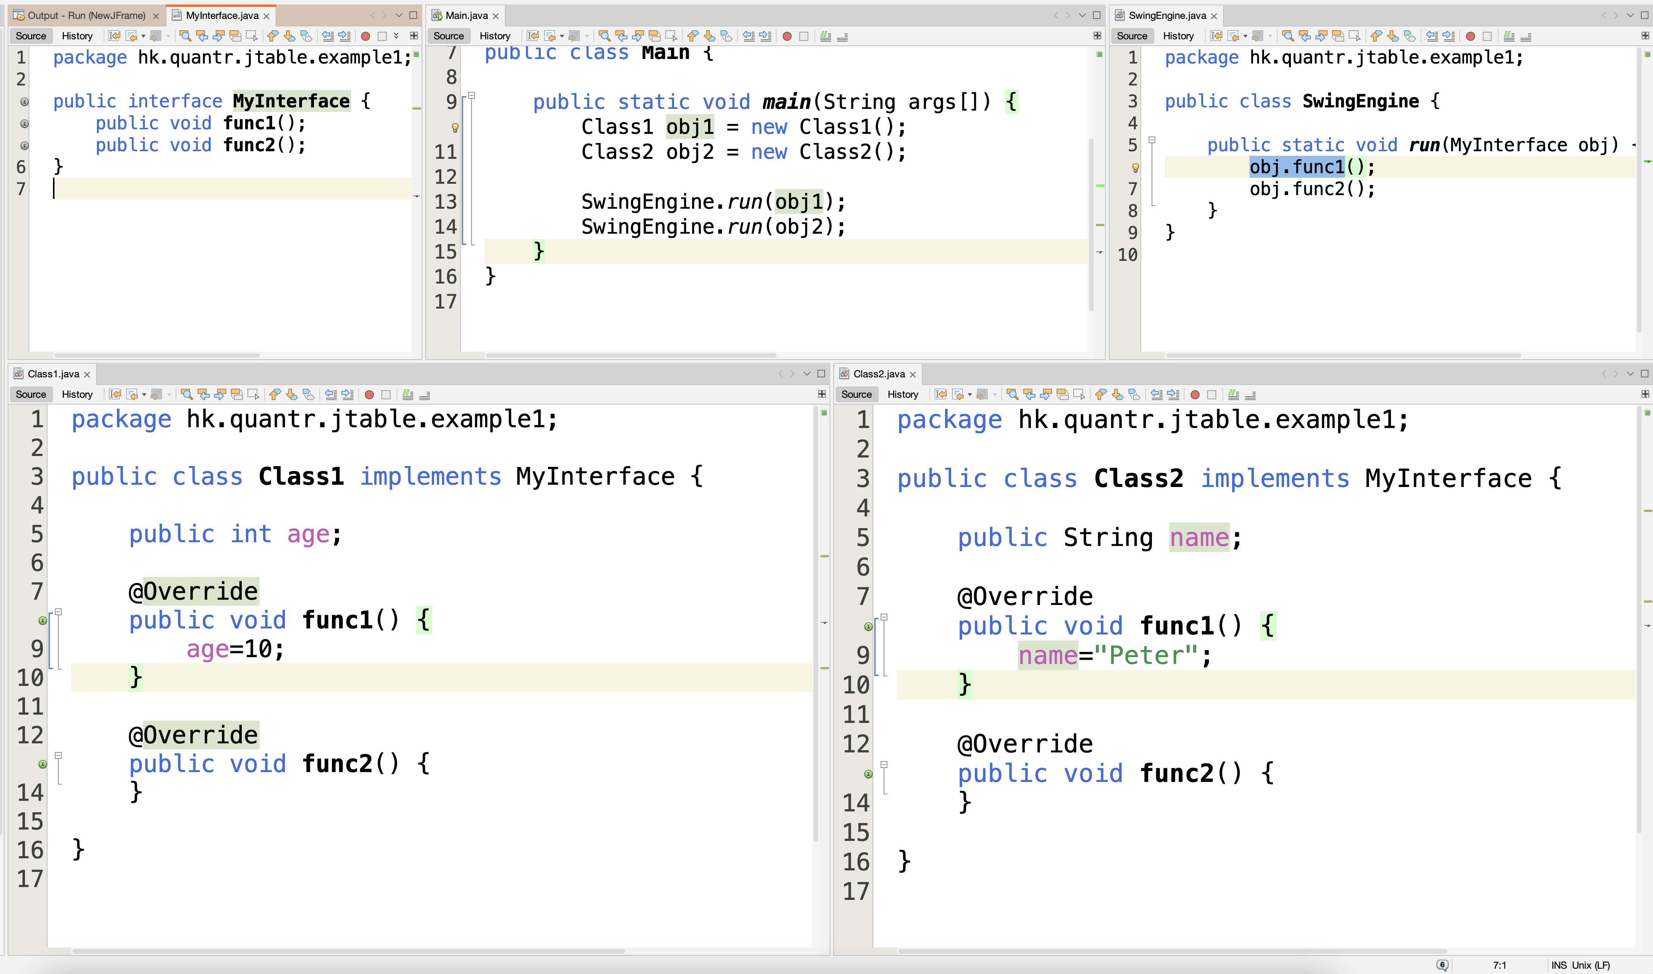

Slide 7
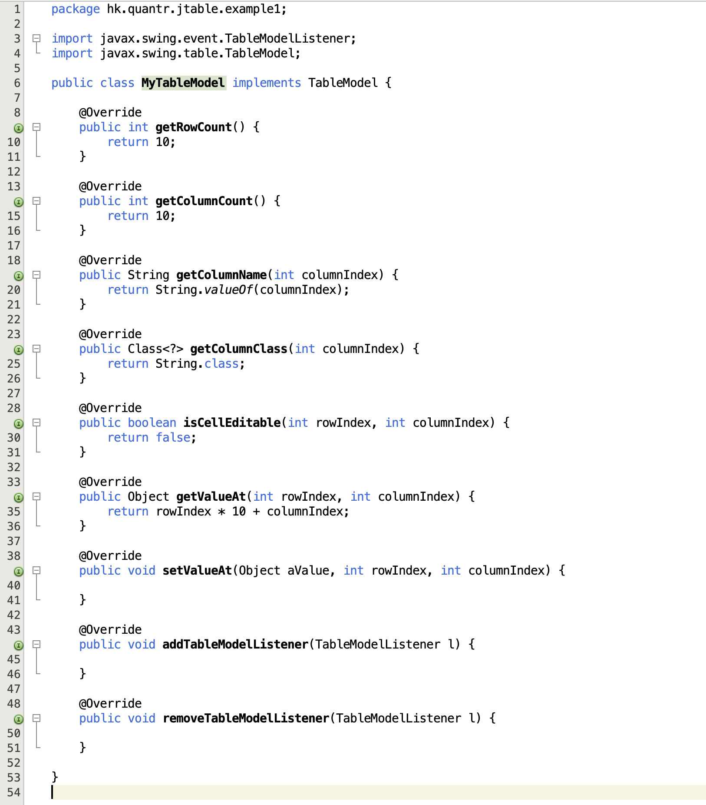

Slide 8
Interface
JFrame
TableModel
JButton
JTable
Swing
Engine
actionListener
Your class
object
function1
function1
function2
function2
function3
Data
function3
Data

Slide 9
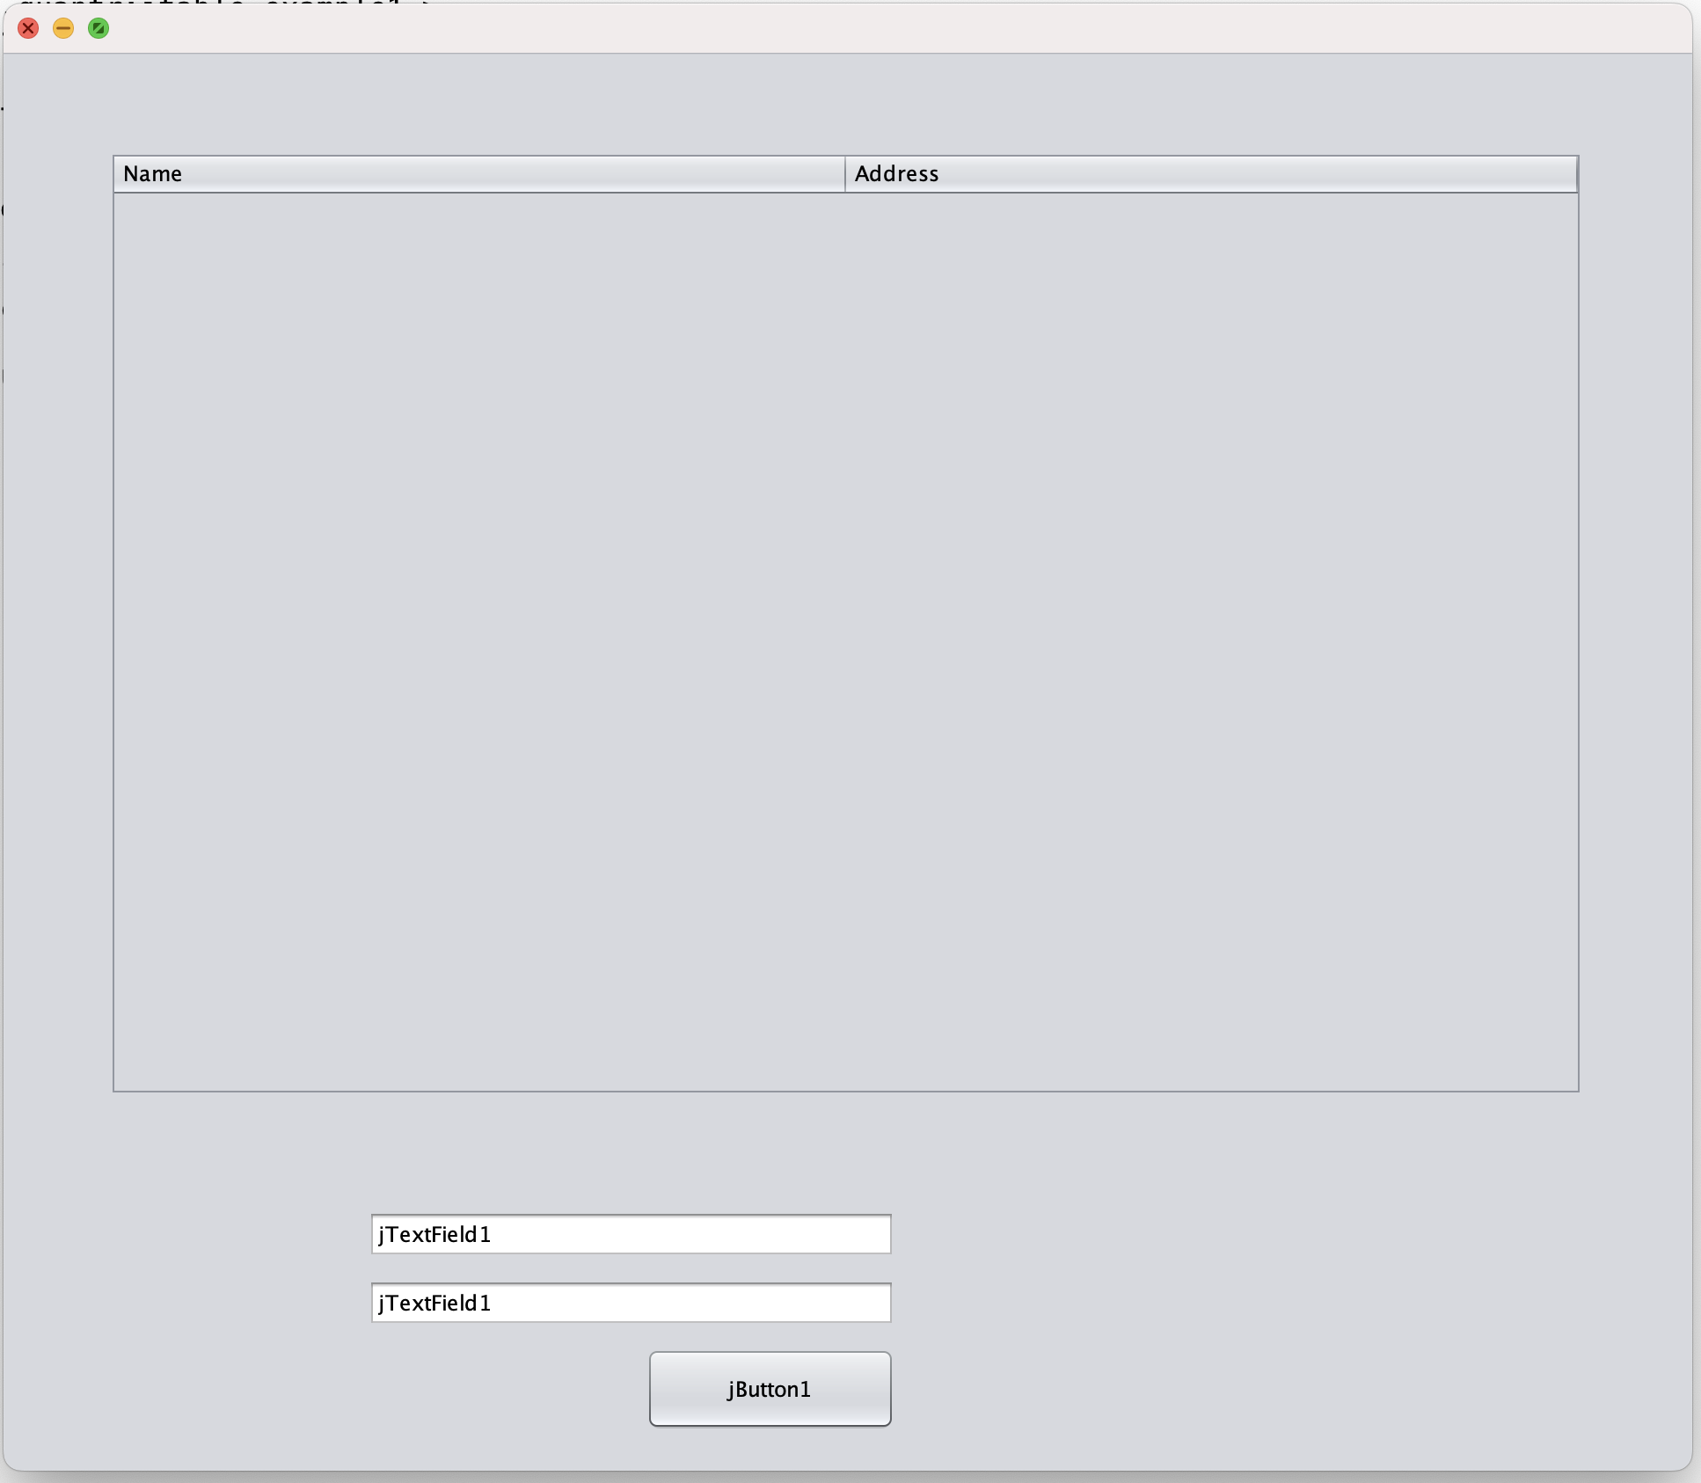
XStream
XML
Serialization

Slide 10
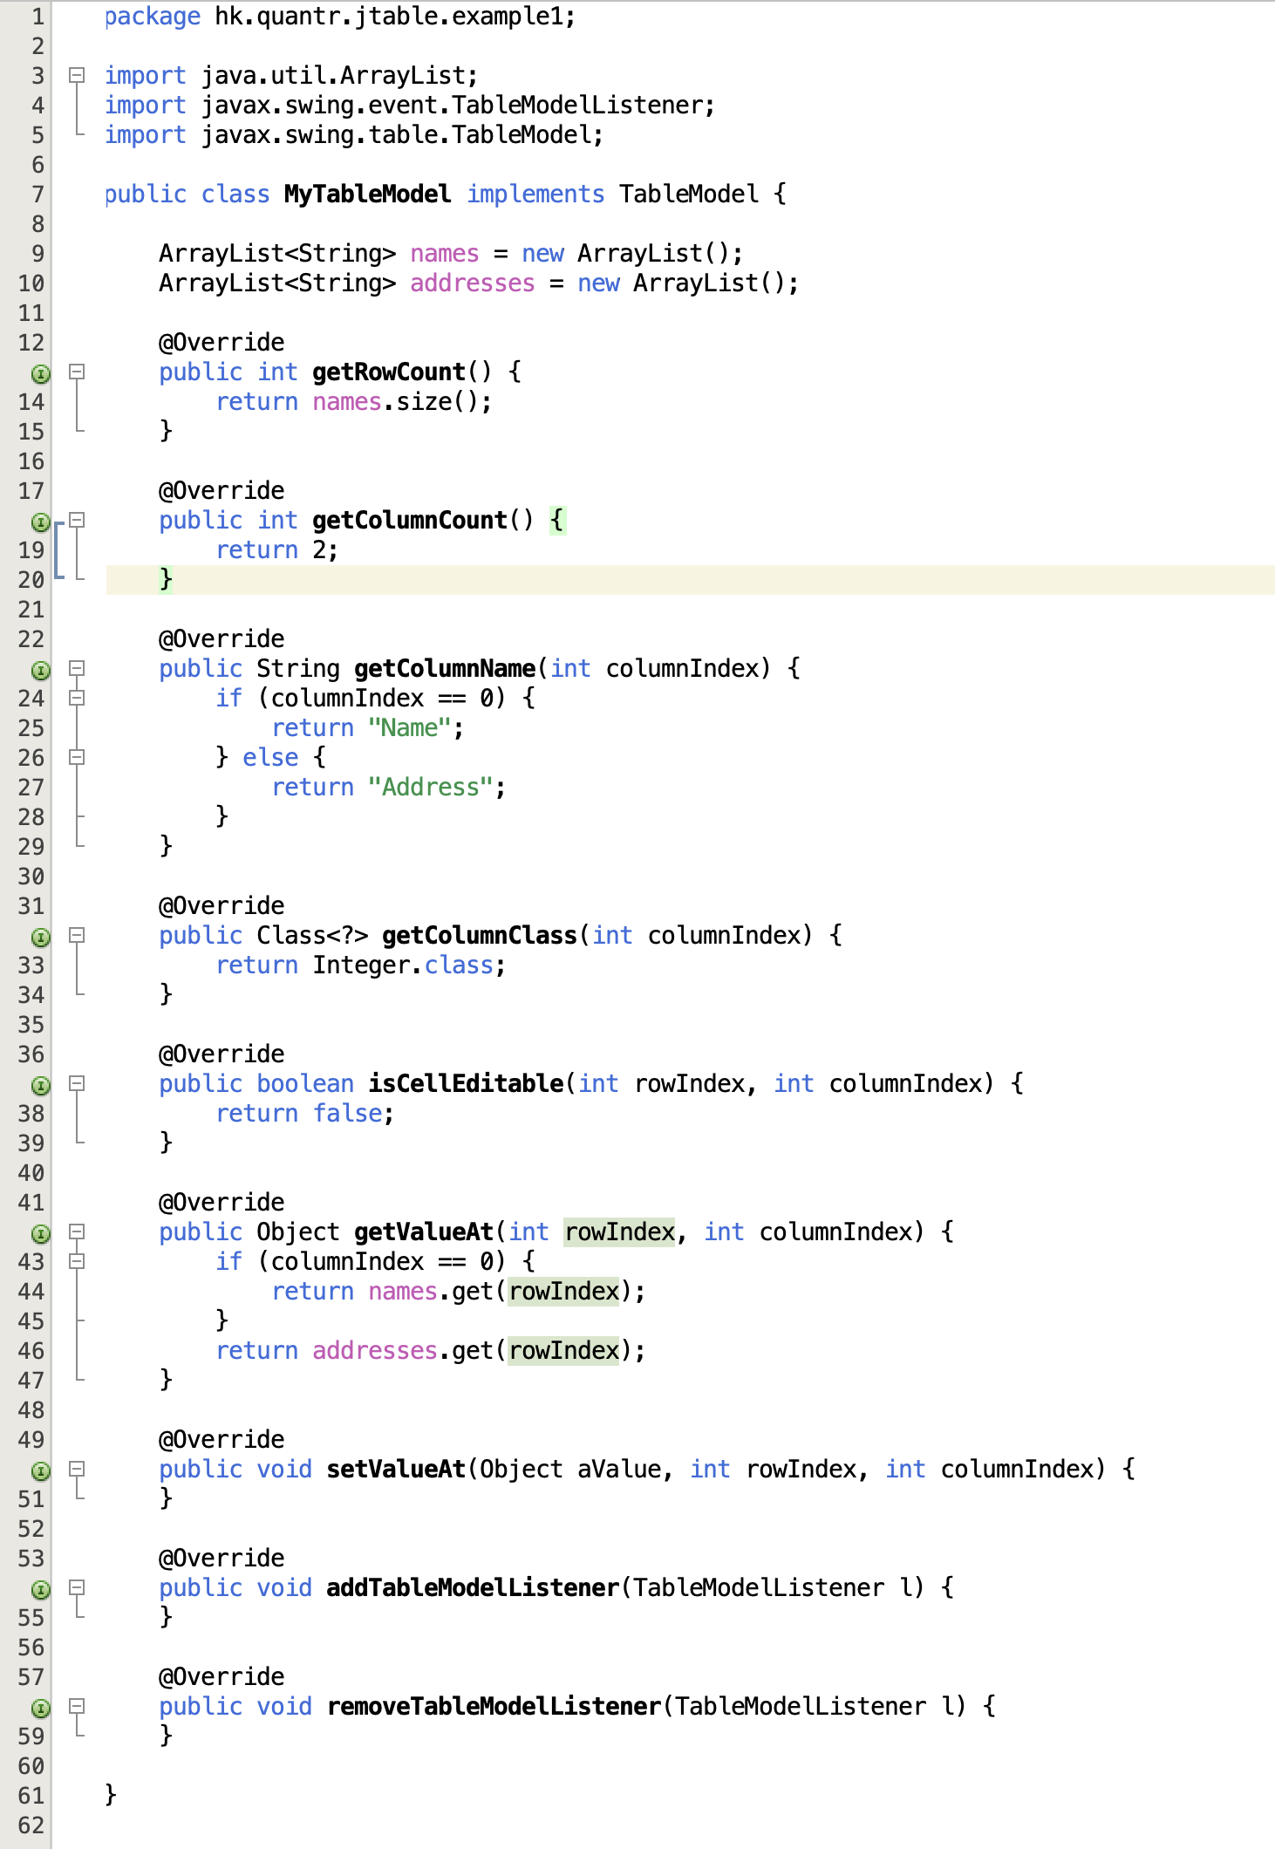

Slide 11
Thank you
香港編程學會
Peter
96554595

