Slide 1
Java第9堂
香港編程學會
Peter

Slide 2
Agenda
Constructor
JDialog, JCheckbox, JComboBox
Inheritance真實應用初體驗
Multi-thread初體驗
香港編程學會

Slide 3
Constructor
A constructor in Java is a special method that is used to initialize objects. The constructor is called when an object of a class is created.

Slide 4
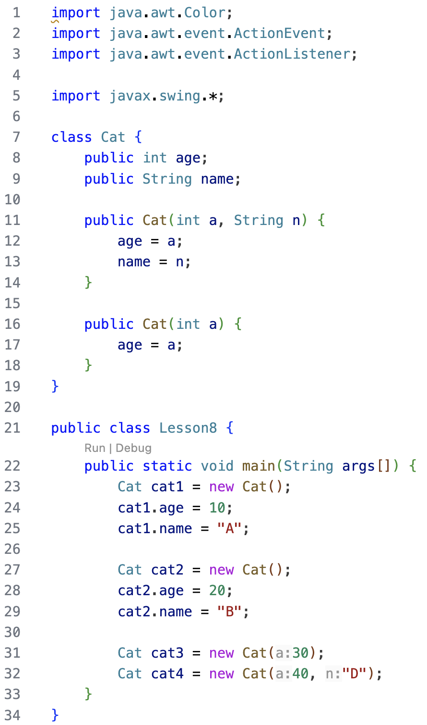

Slide 5
JDialog
JDialog is a part Java swing package. The main purpose of the dialog is to add components to it. JDialog can be customized according to user need .
Constructor of the class are:
JDialog() : creates an empty dialog without any title or any specified owner
JDialog(Frame o) :creates an empty dialog with a specified frame as its owner
JDialog(Frame o, String s) : creates an empty dialog with a specified frame as its owner
and a specified title
JDialog(Window o) : creates an empty dialog with a specified window as its owner
JDialog(Window o, String t) : creates an empty dialog with a specified window as its owner and specified title.
JDialog(Dialog o) :creates an empty dialog with a specified dialog as its owner
JDialog(Dialog o, String s) : creates an empty dialog with a specified dialog as its owner and specified title.
Commonly used methods
setLayout(LayoutManager m) : sets the layout of the dialog to specified layout manager
setJMenuBar(JMenuBar m) : sets the menubar of the dialog to specified menubar
add(Component c): adds component to the dialog
isVisible(boolean b): sets the visibility of the dialog, if value of the boolean is true then visible else invisible
update(Graphics g) : calls the paint(g) function
remove(Component c) : removes the component c
getGraphics() : returns the graphics context of the component.
getLayeredPane() : returns the layered pane for the dialog
setContentPane(Container c) :sets the content pane for the dialog
setLayeredPane(JLayeredPane l) : set the layered pane for the dialog
setRootPane(JRootPane r) : sets the rootPane for the dialog
getJMenuBar() : returns the menubar of the component
setTransferHandler(TransferHandler n) : Sets the transferHandler property, which is a mechanism to support transfer of data into this component.
setRootPaneCheckingEnabled(boolean enabled) : Sets whether calls to add and setLayout are forwarded to the contentPane.
setRootPane(JRootPane root) :Sets the rootPane property of the dialog.
setGlassPane(Component glass) : Sets the glassPane property of the dialog.
repaint(long time, int x, int y, int width, int height): Repaints the specified rectangle of this component within time milliseconds.
remove(Component c): Removes the specified component from the dialog.
isRootPaneCheckingEnabled() : Returns whether calls to add and setLayout are forwarded to the contentPane or not .
getTransferHandler() : returns the transferHandler property.
getRootPane() : Returns the rootPane object for this dialog.
getGlassPane() : Returns the glassPane object for this dialog.
createRootPane() : Called by the constructor methods to create the default rootPane.
addImpl(Component co, Object c, int i) : Adds the specified child Component to the dialog.

Slide 6
JDialog
JDialog d = new JDialog(f, "dialog Box");
d.setLayout(null);
// create a label
JLabel l = new JLabel("this is a dialog box");
l.setLocation(100,100);
l.setSize(100,100);
d.add(l);
// setsize of dialog
d.setSize(100, 100);
// set visibility of dialog
d.setVisible(true);

Slide 7
JCheckbox
JDialog d = new JDialog(f, "dialog Box");
d.setLayout(null);
// create a checkbox
JCkecbox c = new JCkecbox(“checkbox one");
c.setLocation(100,100);
c.setSize(100,100);
d.add(c);
// setsize of dialog
d.setSize(100, 100);
// set visibility of dialog
d.setVisible(true);

Slide 8
JComboBox
String s1[] = {“one“, “Two”, “Three” };
// create checkbox
JComboBox c1 = new JComboBox(s1);

Slide 9
Multi-thread示範一
import java.awt.Color;
import java.awt.event.ActionEvent;
import java.awt.event.ActionListener;
import java.lang.*;
import javax.swing.*;
class X implements Runnable {
public void run() {
for (int x = 0; x < 10; x++) {
System.out.println(x);
try{
Thread.sleep(100);
}catch(Exception ex){}
}
}
}
public class Lesson9b {
public static void main(String args[]) {
X x1 = new X();
// x1.run(); <-- single thread
Thread t1 = new Thread(x1);
t1.start();
X x2 = new X();
Thread t2 = new Thread(x2);
t2.start();
}
}

Slide 10
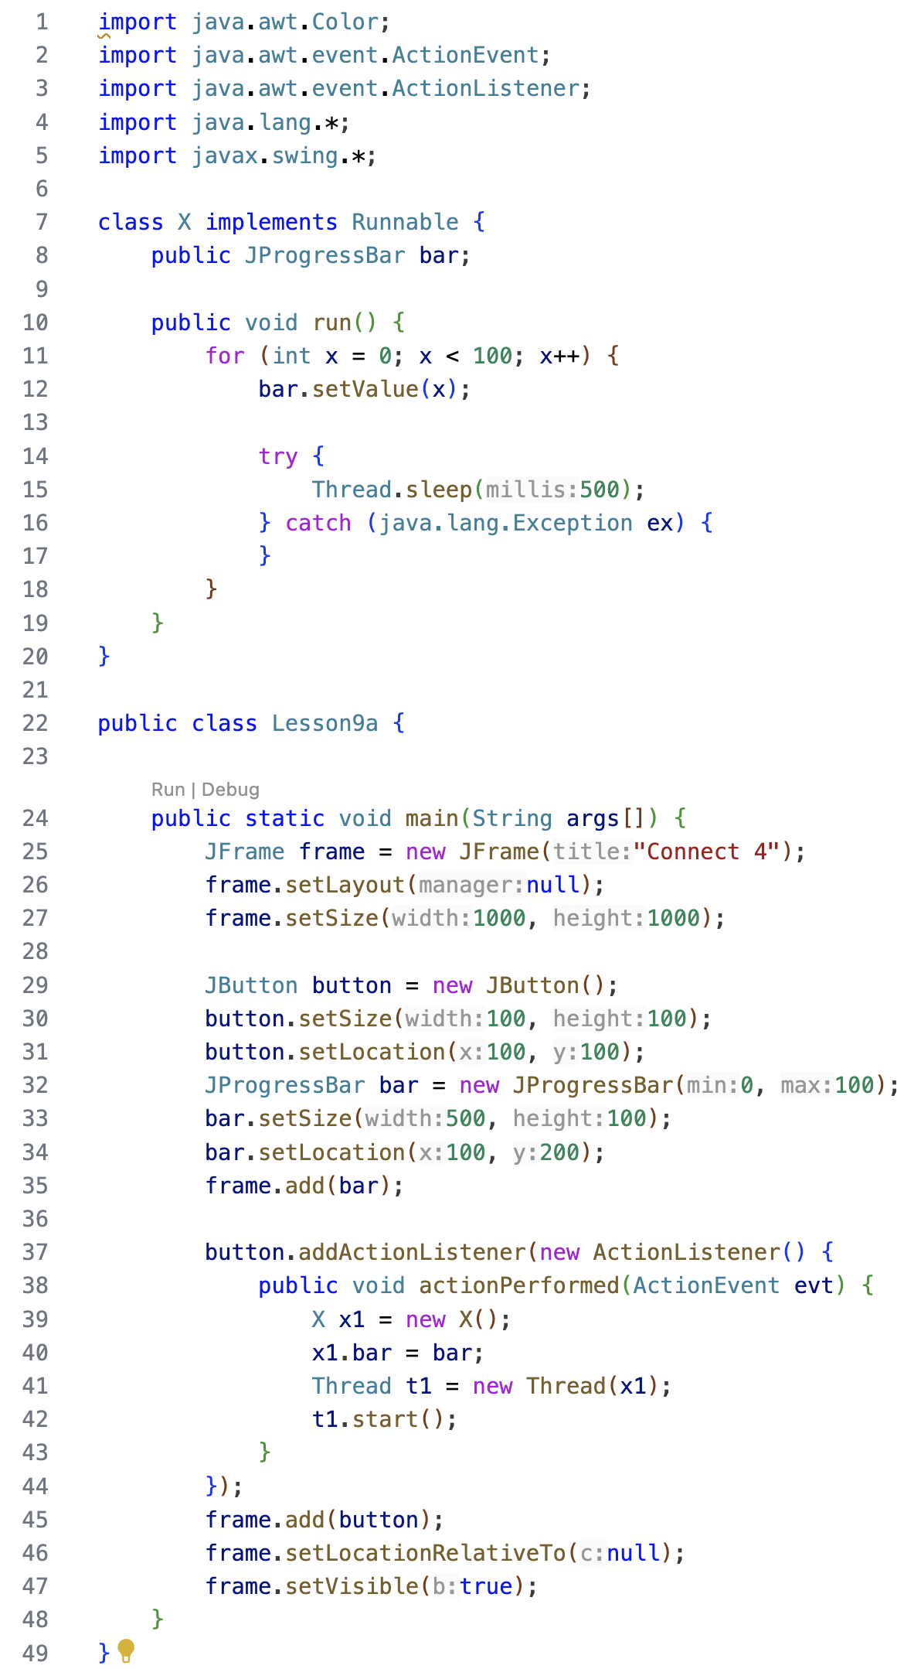
Multi-thread 示範二

Slide 11
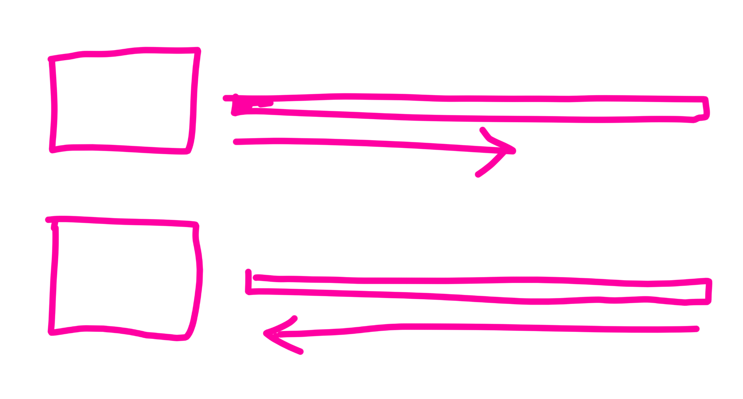
功課

Slide 12
Thank you
香港編程學會
Peter
96554595

