Slide 1
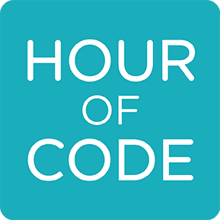
Java第8堂
香港編程學會
Peter

Slide 2
Agenda
Function Overriding
Static Function
Variable Scope
Event handling (by interface or class)
Swing component
香港編程學會

Slide 3
Static Function
Static function只可以存取Static variable

Slide 4
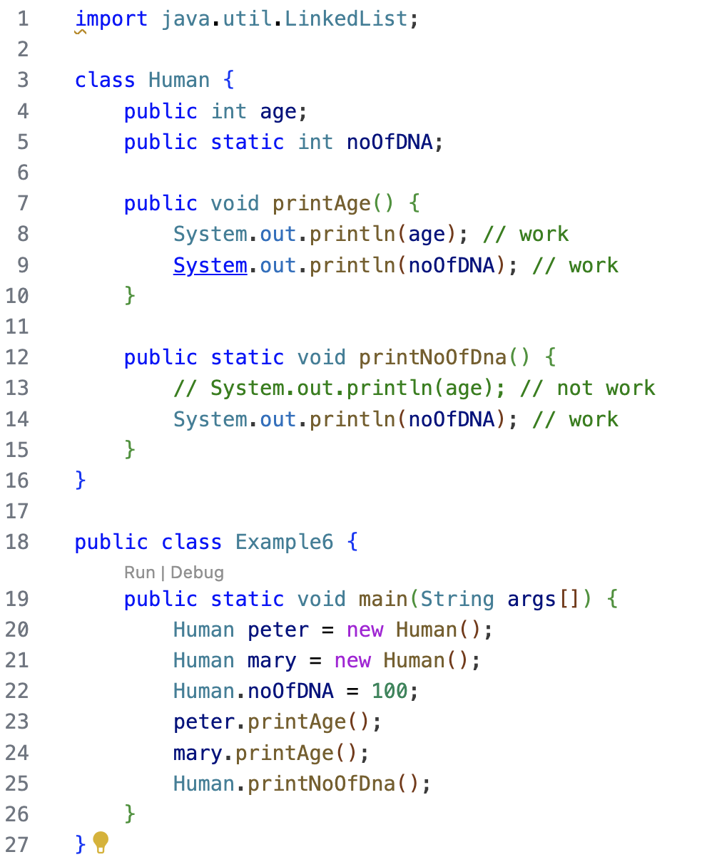

Slide 5
Overriding
If subclass (child class) has the same method as declared in the parent class, it is known as method overriding in Java.

Slide 6
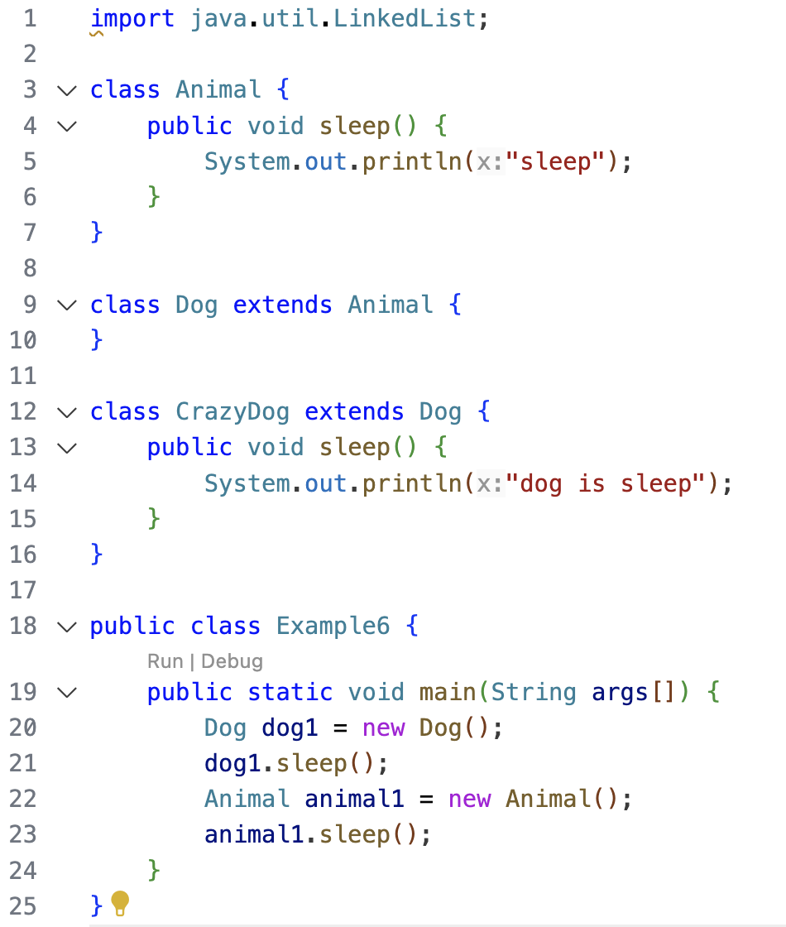

Slide 7
Variable Scope變數範圍
最近嘅開關括號(向上睇)

Slide 8
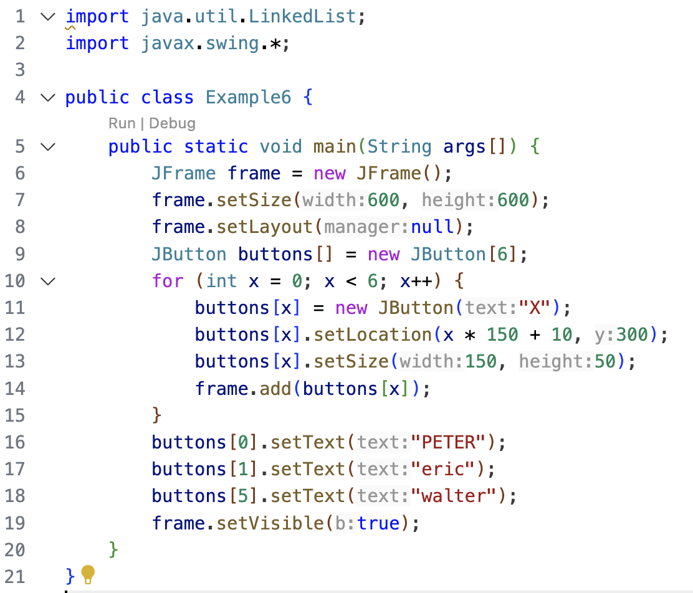

Slide 9
Interface Again
An interface is used to apply special ability to class

Slide 10
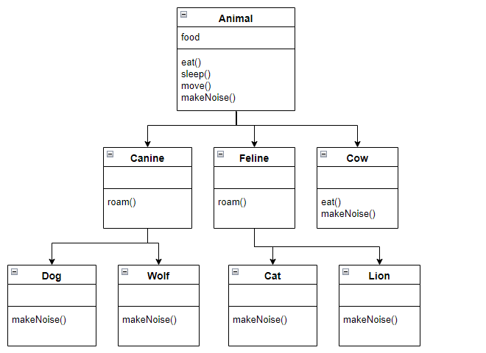
Interface CanSwim
Interface指定能力
Interface指定能力

Slide 11
ActionListener

Slide 12
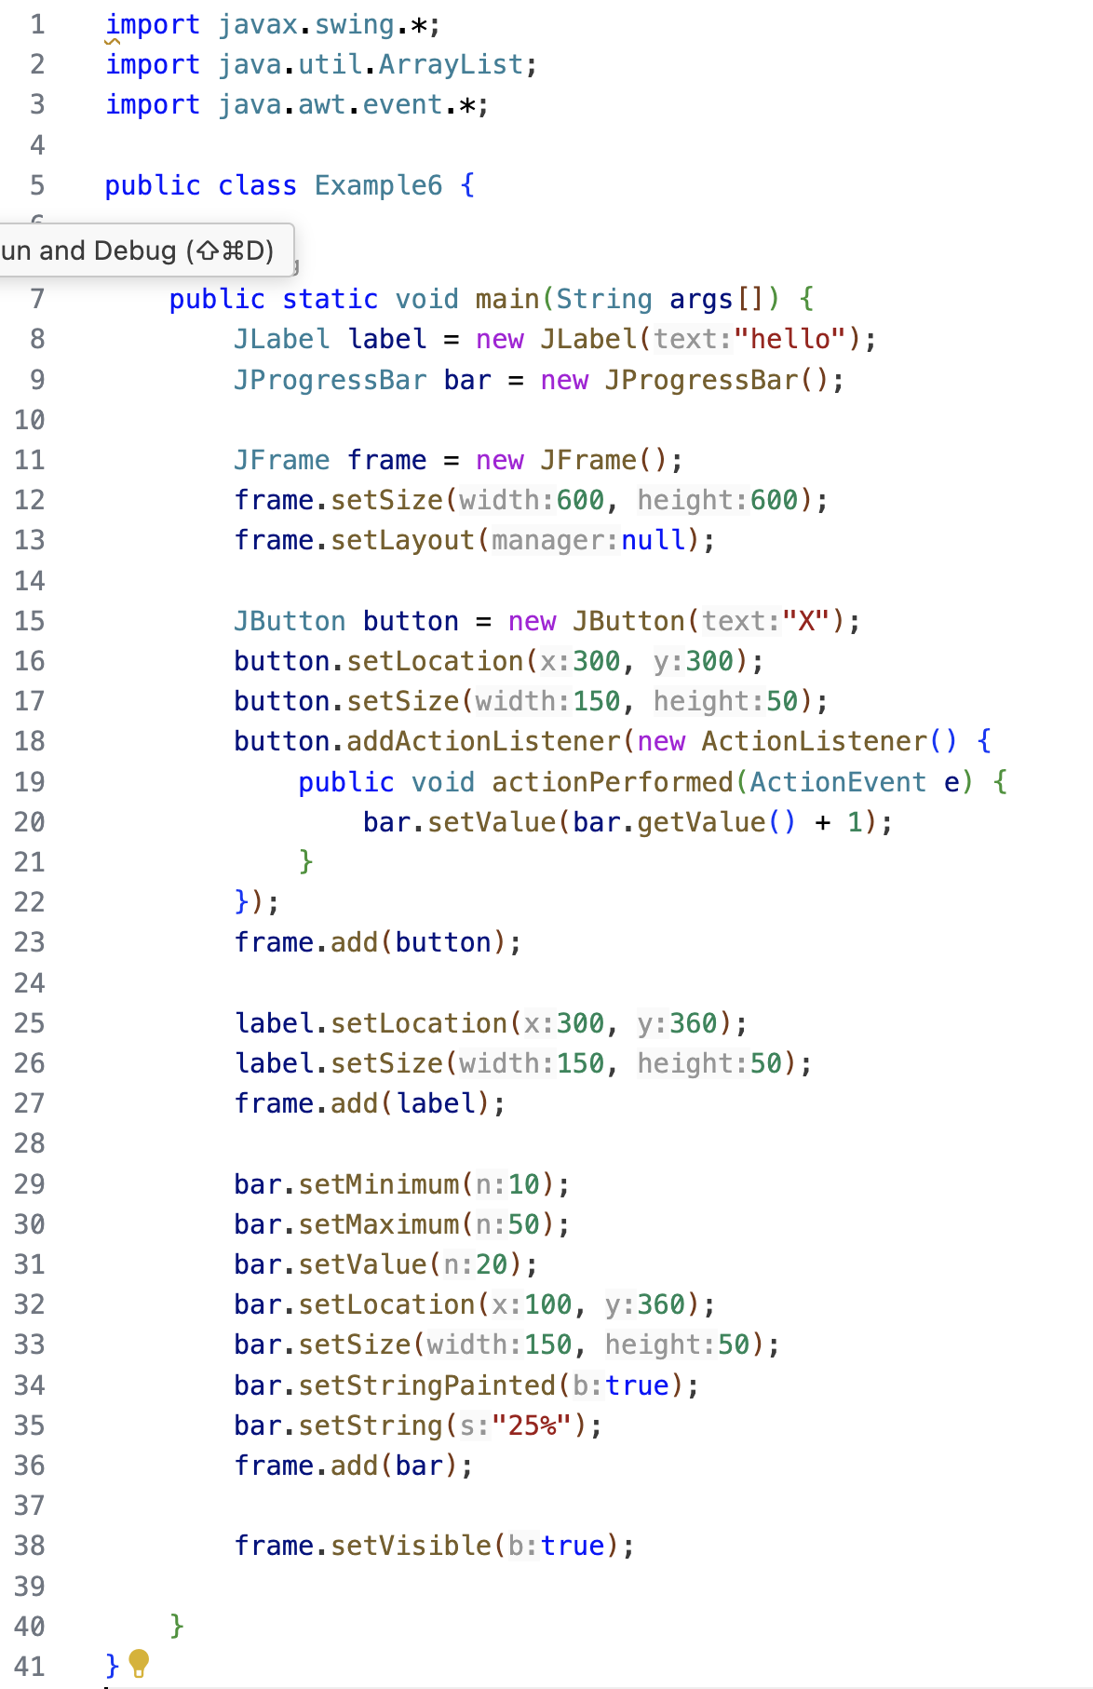

Slide 13
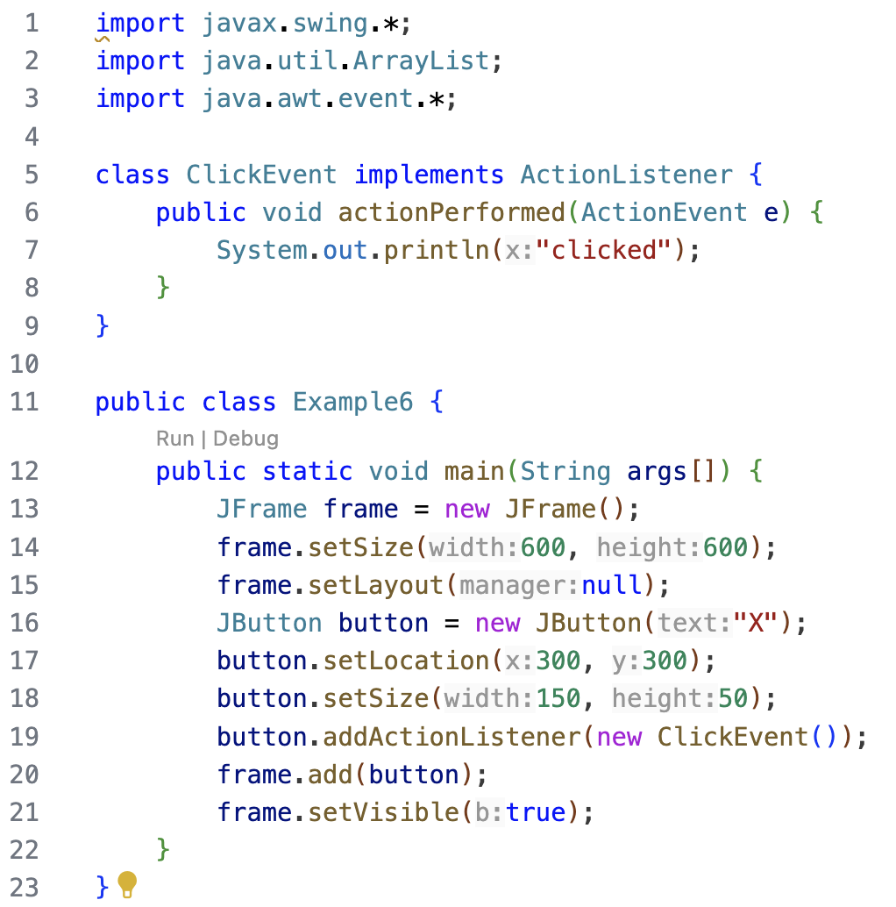

Slide 14
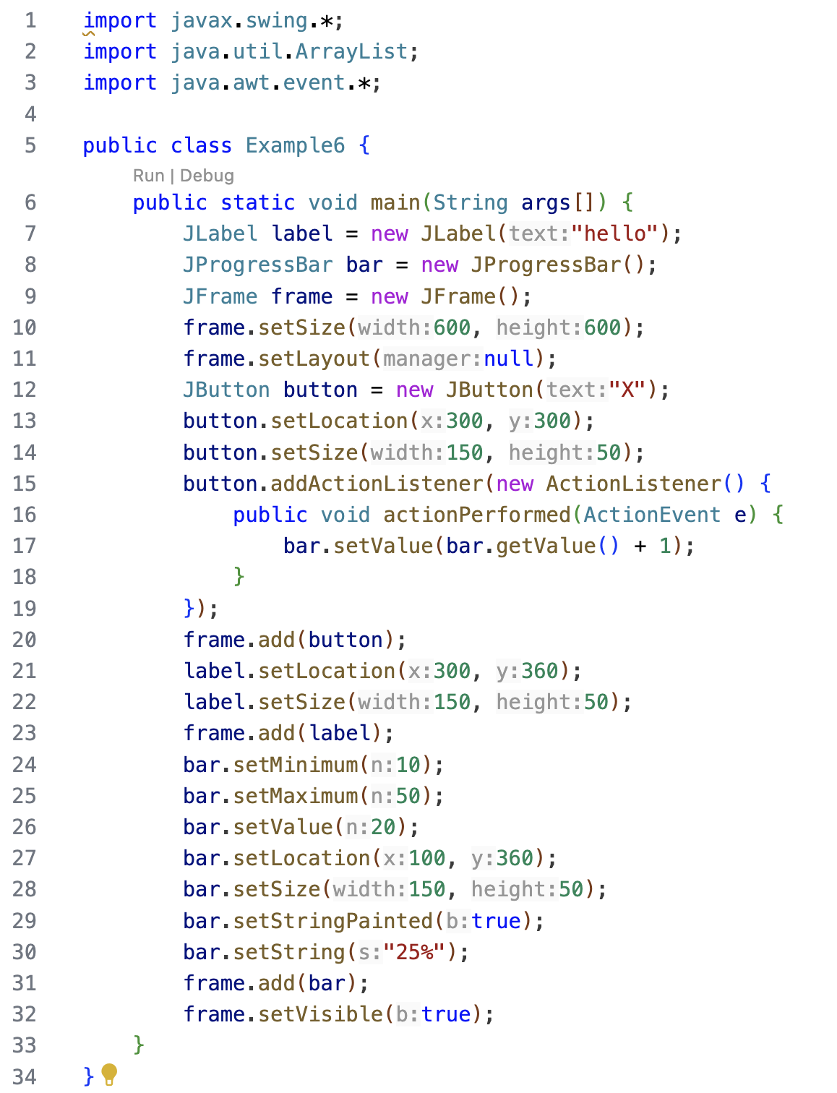

Slide 15
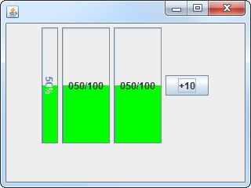
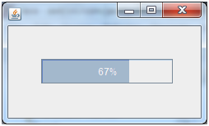
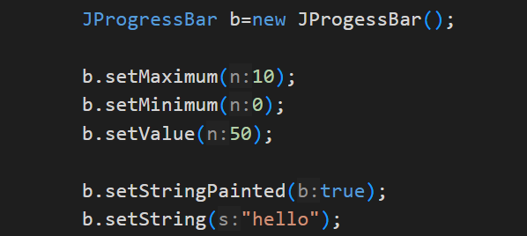
JProgressBar

Slide 16
Thank you
香港編程學會
Peter
96554595

