Slide 1
Java第7堂
香港編程學會
Peter

Slide 2
Agenda
Interface
Exception
OOP
香港編程學會

Slide 3
What Interface
An interface in Java is a blueprint of a class. It has static constants and abstract methods.
Java 中的介面是類別的藍圖。它有靜態常數和抽象方法

Slide 4
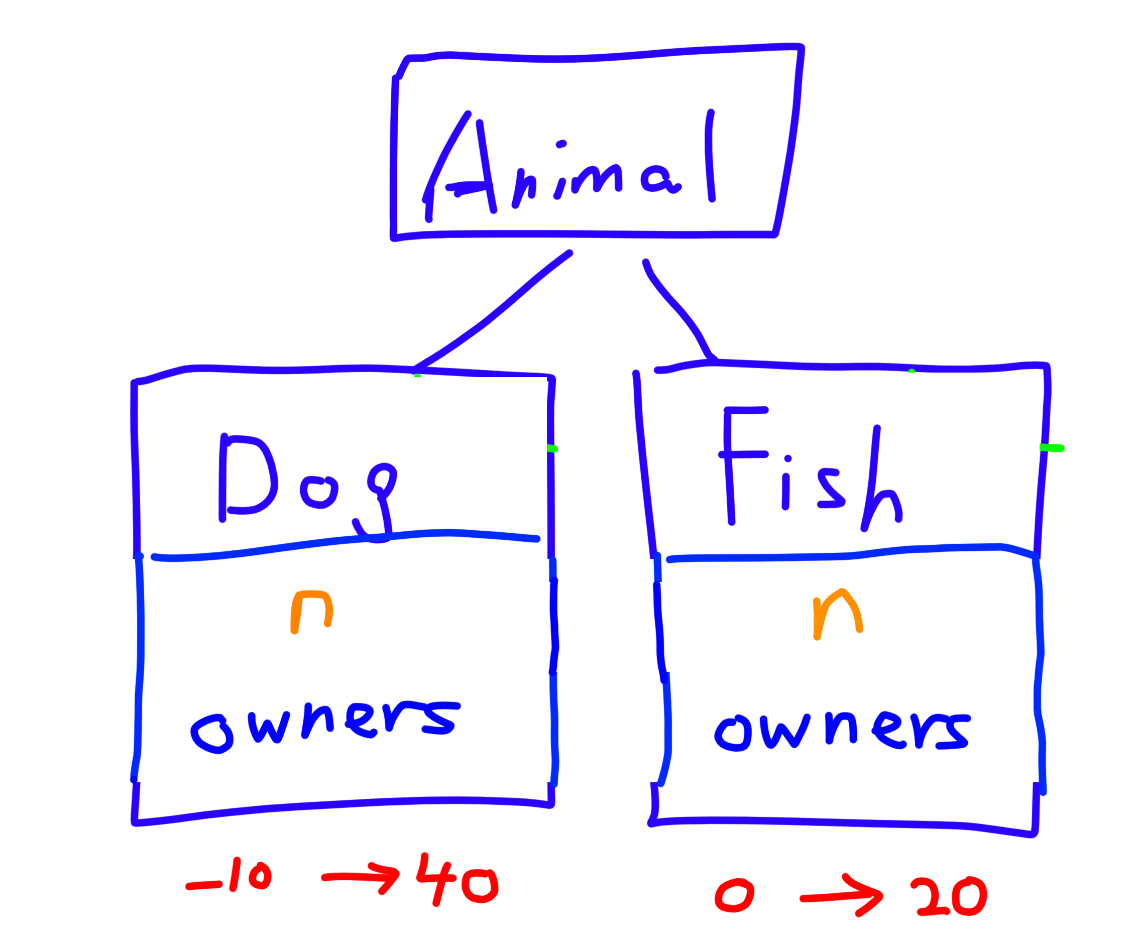
功課

Slide 5
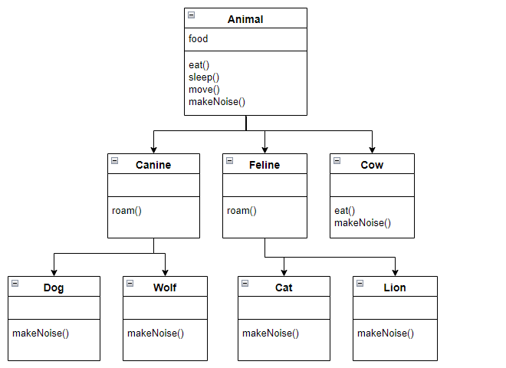
Interface CanSwim
Interface指定能力
Interface指定能力

Slide 6
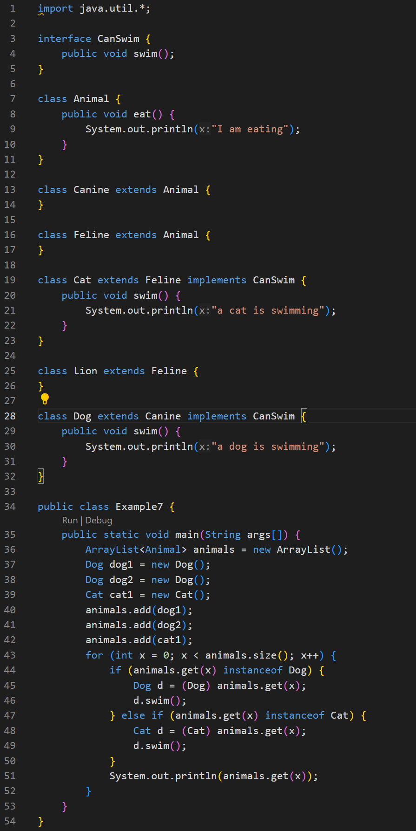
Polymorphism 多態(i)

Slide 7
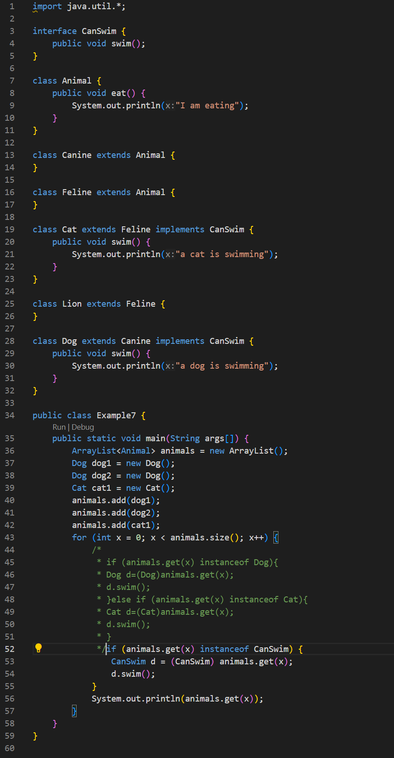
Polymorphism 多態(ii)
功課: 數下ArrayList有幾多隻貓同狗

Slide 8
Exception
When executing Java code, different errors can occur: coding errors made by the programmer, errors due to wrong input, or other unforeseeable things.

Slide 9
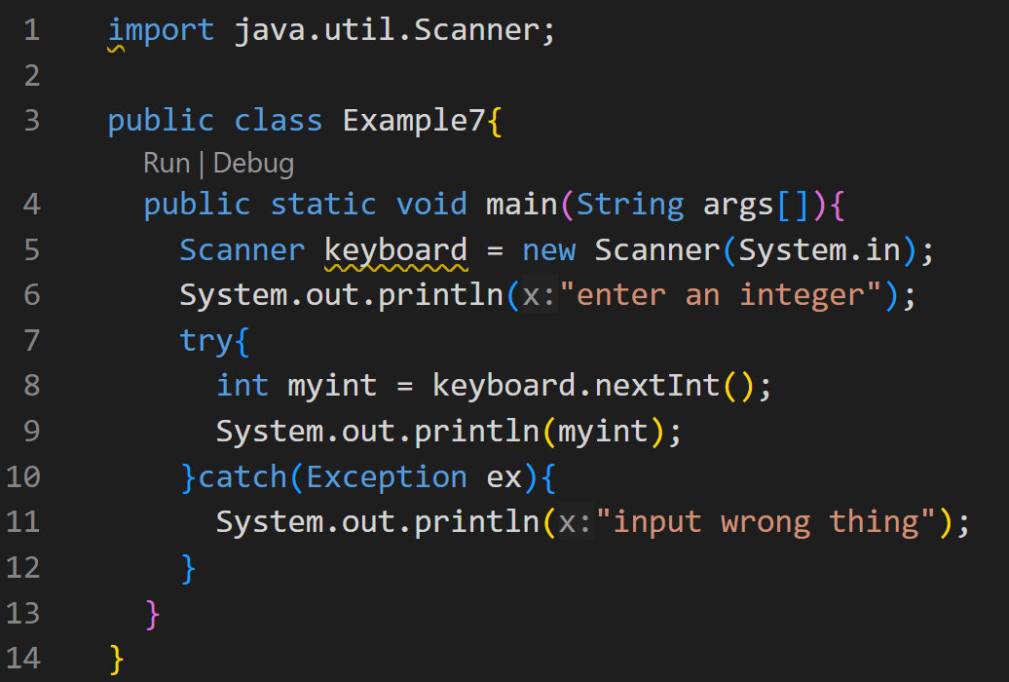
Excepion例子

Slide 10
Java Swing
Swing is a Java Foundation Classes [JFC] library and an extension of the Abstract Window Toolkit [AWT]. Java Swing offers much-improved functionality over AWT, new components, expanded components features, and excellent event handling with drag-and-drop support.

Slide 12
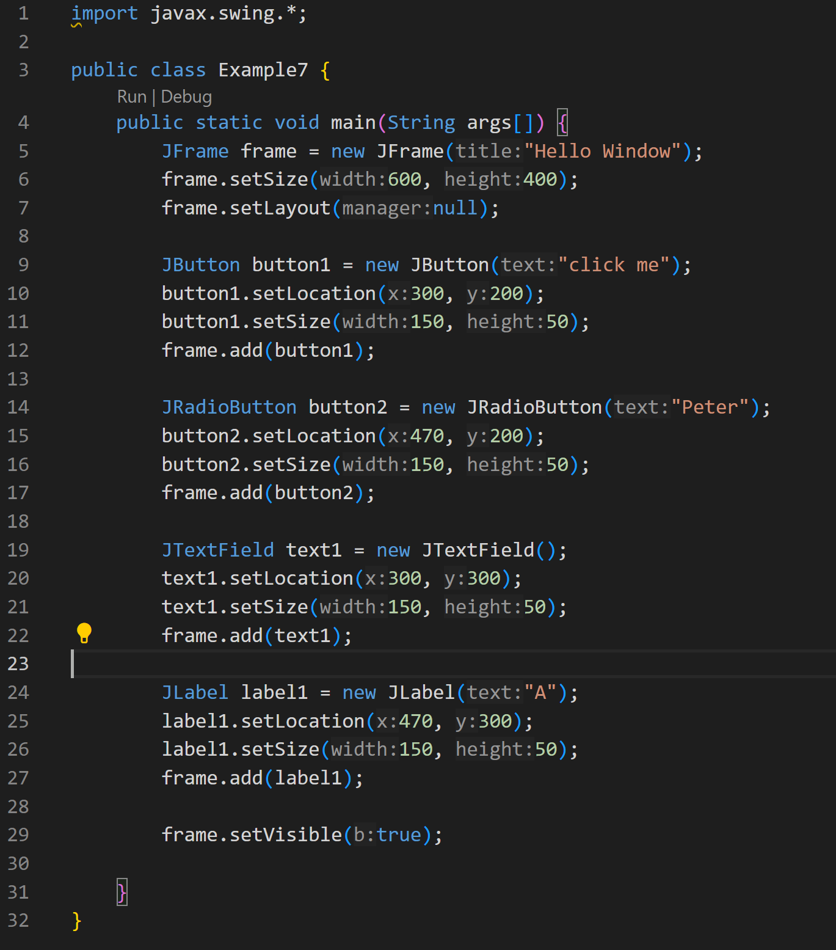

Slide 13
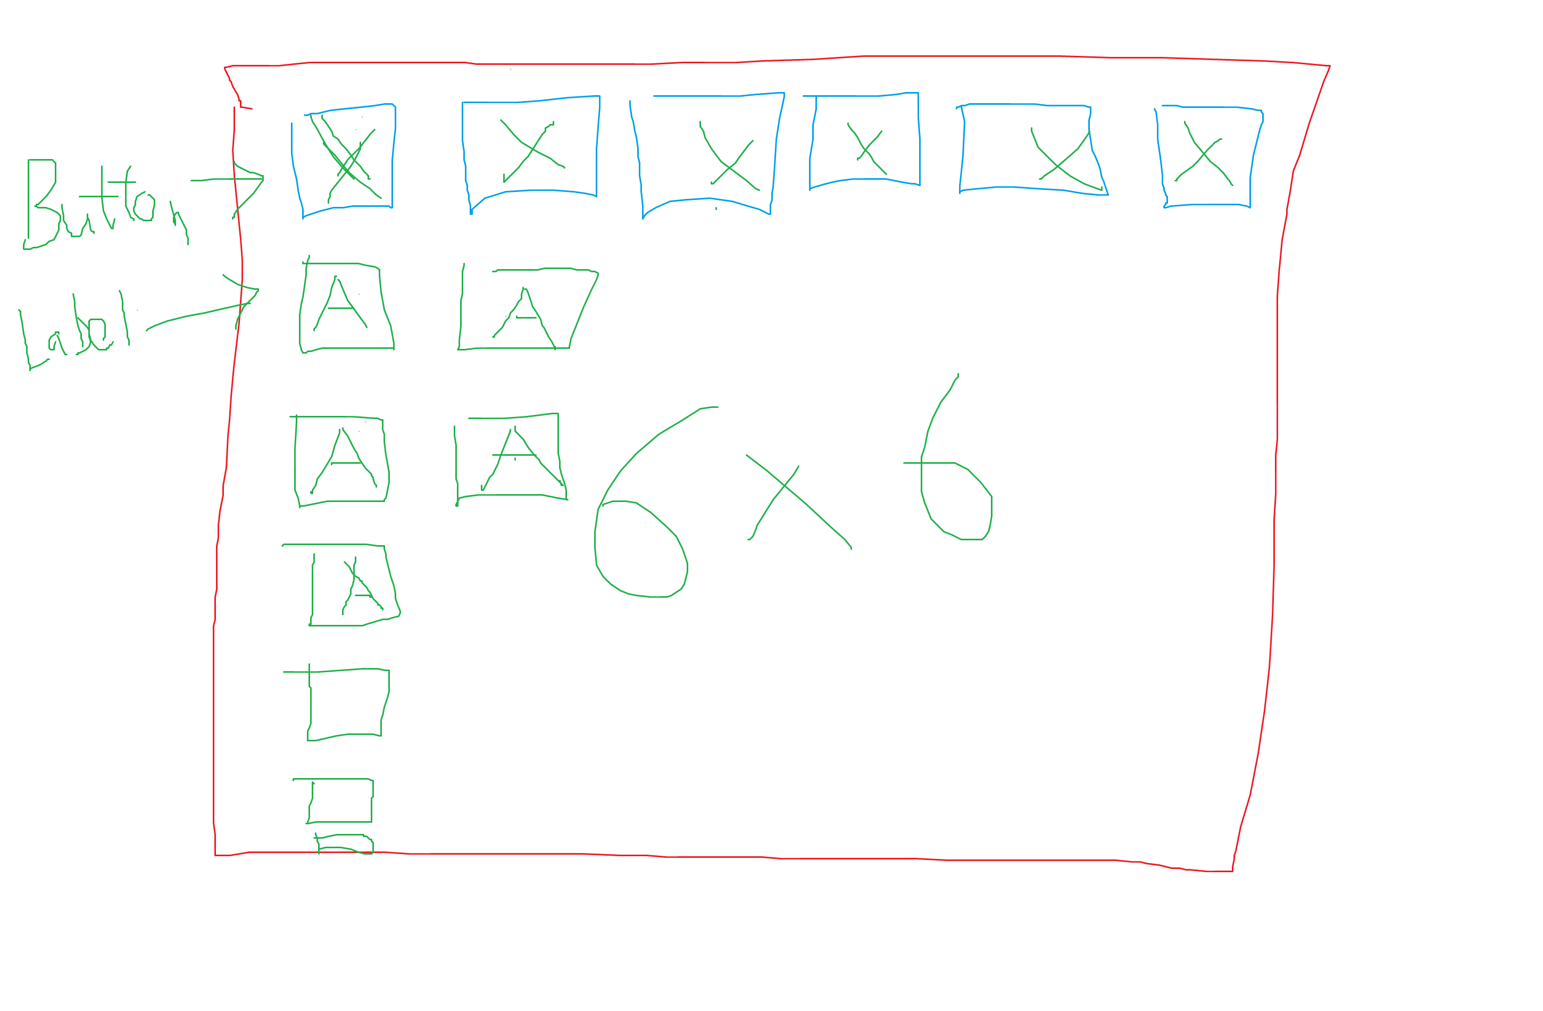
功課

Slide 14
Thank you
香港編程學會
Peter
96554595

